Slide 1
HOUSE PRICING PREDICTION
House pricing prediction using python

Slide 2
At some point in life, we will all have the experience to look up for a new house to buy.
So to deal with this kind of issue Today we will be preparing a MACHINE LEARNING Based model, trained on the House Price Prediction Dataset.
We will get our dataset from Kaggle.

Slide 3
Importing Libraries and Dataset
Matplotlib- To visualize the data features i.e histogram and scatter plot.
Pandas- To load the dataframe.
import pandas as pd
import numpy as np
import matplotlib.pyplot as plt
data=pd.read_csv("/content/sample_data/california_housing_test.csv“)
print(data)
data.head()

Slide 4
Output:
longitude latitude housing_median_age total_rooms total_bedrooms \
0 -122.05 37.37 27.0 3885.0 661.0
1 -118.30 34.26 43.0 1510.0 310.0
2 -117.81 33.78 27.0 3589.0 507.0
3 -118.36 33.82 28.0 67.0 15.0
4 -119.67 36.33 19.0 1241.0 244.0
... ... ... ... ... ...
2995 -119.86 34.42 23.0 1450.0 642.0
2996 -118.14 34.06 27.0 5257.0 1082.0
2997 -119.70 36.30 10.0 956.0 201.0
2998 -117.12 34.10 40.0 96.0 14.0
2999 -119.63 34.42 42.0 1765.0 263.0

Slide 5
population households median_income median_house_value
0 1537.0 606.0 6.6085 344700.0
1 809.0 277.0 3.5990 176500.0
2 1484.0 495.0 5.7934 270500.0
3 49.0 11.0 6.1359 330000.0
4 850.0 237.0 2.9375 81700.0
... ... ... ... ...
2995 1258.0 607.0 1.1790 225000.0
2996 3496.0 1036.0 3.3906 237200.0
2997 693.0 220.0 2.2895 62000.0
2998 46.0 14.0 3.2708 162500.0
2999 753.0 260.0 8.5608 500001.0

Slide 6
[3000 rows x 9 columns]
longitude latitude housing_median_age total_rooms total_bedrooms population households median_income median_house_value
0 -122.05 37.37 27.0 3885.0 661.0 1537.0 606.0 6.6085 344700.0
1 -118.30 34.26 43.0 1510.0 310.0 809.0 277.0 3.5990 176500.0
2 -117.81 33.78 27.0 3589.0 507.0 1484.0 495.0 5.7934 270500.0
3 -118.36 33.82 28.0 67.0 15.0 49.0 11.0 6.1359 330000.0
4 -119.67 36.33 19.0 1241.0 244.0 850.0 237.0 2.9375 81700.0

Slide 7
Exploratory Data Analysis
Used to analyze and investigate data sets and summarize their main characteristics, often employing data visualization methods.
plt.hist(data['median_house_value'], bins=50)
plt.xlabel('median_house_value')
plt.ylabel('Frequency')
plt.title('Distribution of Median House Prices')
plt.show()

Slide 8
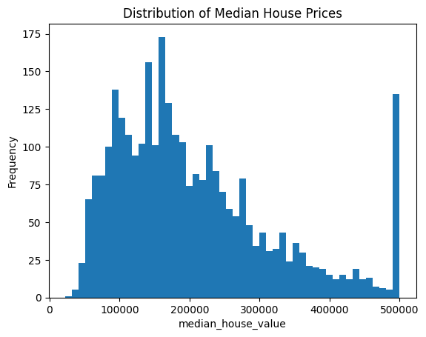
Output:

Slide 9
plt.scatter(data['median_income'],data['median_house_value'])
plt.xlabel('median_income')
plt.ylabel('median_house_value')
plt.title('Relationship between median_income and median_house_value' )
plt.show()

Slide 10
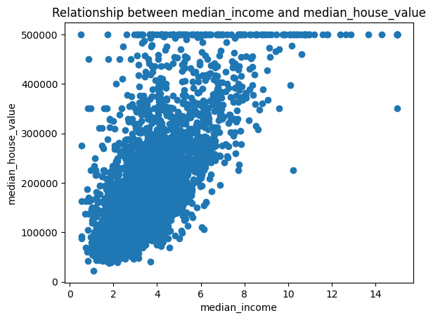
Output:

Slide 11
Splitting Dataset into Training and Testing
X and Y splitting (i.e. Y is the Sale Price column and the rest of the other columns are X)
Splitting the data into training and testing data
We want to train them all on one set of data and we want to evaluate it on another set.
We are not going to work with all of the data because we need to have some unseen data that the model has never seen before to see if it performs well on this data.
from sklearn.model_selection import train_test_split
x=data.drop(['median_house_value'],axis=1)
y=data['median_house_value']
print(x)
print(y)

Slide 12
Output:
longitude latitude housing_median_age total_rooms total_bedrooms \
0 -122.05 37.37 27.0 3885.0 661.0
1 -118.30 34.26 43.0 1510.0 310.0
2 -117.81 33.78 27.0 3589.0 507.0
3 -118.36 33.82 28.0 67.0 15.0
4 -119.67 36.33 19.0 1241.0 244.0
... ... ... ... ... ...
2995 -119.86 34.42 23.0 1450.0 642.0
2996 -118.14 34.06 27.0 5257.0 1082.0
2997 -119.70 36.30 10.0 956.0 201.0
2998 -117.12 34.10 40.0 96.0 14.0
2999 -119.63 34.42 42.0 1765.0 263.0

Slide 13
Output:
population households median_income
0 1537.0 606.0 6.6085
1 809.0 277.0 3.5990
2 1484.0 495.0 5.7934
3 49.0 11.0 6.1359
4 850.0 237.0 2.9375
... ... ... ...
2995 1258.0 607.0 1.1790
2996 3496.0 1036.0 3.3906
2997 693.0 220.0 2.2895
2998 46.0 14.0 3.2708
2999 753.0 260.0 8.5608

Slide 14
Output:
[3000 rows x 8 columns]
0 344700.0
1 176500.0
2 270500.0
3 330000.0
4 81700.0
...
2995 225000.0
2996 237200.0
2997 62000.0
2998 162500.0
2999 500001.0
Name: median_house_value, Length: 3000, dtype: float64

Slide 15
Splitting Dataset into Training and Testing
20% of the data will be reserved for evaluation for testing while the rest which is 80% will be used for training.
The test data will be used once we have done with the training, so when we are confident we can launch the model.
x_train, X_test, y_train, y_test = train_test_split(x,y,test_size=0.2, train_size=0.8, random_state=0)
train_data=x_train.join(y_train)
print(train_data)

Slide 16
Output:
longitude latitude housing_median_age total_rooms total_bedrooms \
2370 -122.05 37.31 25.0 4601.0 696.0
1774 -118.16 33.96 24.0 1635.0 507.0
731 -121.69 36.62 19.0 1907.0 323.0
271 -121.96 37.33 35.0 2294.0 411.0
1077 -122.30 37.81 52.0 572.0 109.0
... ... ... ... ... ...
763 -117.31 33.17 7.0 2349.0 312.0
835 -122.25 37.89 41.0 1125.0 195.0
1653 -116.98 33.26 12.0 5898.0 1002.0
2607 -120.69 38.44 13.0 1473.0 265.0
2732 -119.60 36.58 28.0 1452.0 300.0

Slide 17
Output:
population households median_income median_house_value
2370 2003.0 666.0 8.0727 455500.0
1774 2480.0 481.0 2.4432 187500.0
731 681.0 270.0 6.0332 244900.0
271 1054.0 449.0 4.0667 276900.0
1077 274.0 82.0 1.8516 85000.0
... ... ... ... ...
763 809.0 282.0 5.5520 283900.0
835 356.0 181.0 6.1593 344000.0
1653 3129.0 945.0 4.7647 254100.0
2607 597.0 228.0 4.2917 121300.0
2732 919.0 308.0 2.8287 73100.0
[2400 rows x 9 columns]

Slide 18
To get multiple histograms for the distribution of the individual features.
train_data.hist(figsize=(15,10))
Output:
array([[<Axes: title={'center': 'longitude'}>,
<Axes: title={'center': 'latitude'}>,
<Axes: title={'center': 'housing_median_age'}>],
[<Axes: title={'center': 'total_rooms'}>,
<Axes: title={'center': 'total_bedrooms'}>,
<Axes: title={'center': 'population'}>],
[<Axes: title={'center': 'households'}>,
<Axes: title={'center': 'median_income'}>,
<Axes: title={'center': 'median_house_value'}>]], dtype=object)

Slide 19
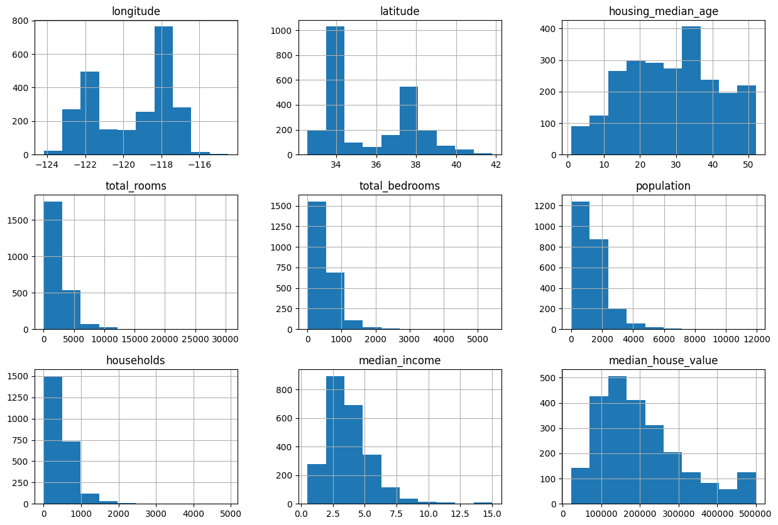
Output:

Slide 20
Model and Accuracy
So we have trained the model to determine the continuous values hence will be using regression models to get the accuracy of the model:
Support vector machine
Random Forest Regressor
Linear Regressor
To calculate loss will be using the mean absolute percentage error. It can be easily imported from the sklearn library.

Slide 21
SVM – Support vector Machine
SVM can be used for both regression and classification model. It finds the hyperplane in the n-dimensional plane.
from sklearn import svm
from sklearn.svm import SVC
from sklearn.metrics import mean_absolute_percentage_error
model_SVR = svm.SVR()
model_SVR.fit(x_train, y_train)
y_pred = model_SVR.predict(x_train)
print(mean_absolute_percentage_error(y_train, y_pred))
Output:
0.5041030414626151

Slide 22
Random Forest Regression
a technique that fits a number of classifying decision trees on various sub-samples of the dataset and uses averaging to improve the predictive accuracy and control over-fitting.
from sklearn.ensemble import RandomForestRegressor
model_RFR = RandomForestRegressor()
model_RFR.fit(x_train, y_train)
model_RFR.score(x_train, y_train)
Output :
0.9623711947266792

Slide 23
Linear Regression
is used to predict the value of a variable based on the value of another variable. The variable you want to predict is called the dependent variable. The variable you are using to predict the other variable's value is called the independent variable.
from sklearn.linear_model import LinearRegression
model_LR = LinearRegression()
model_LR.fit(x_train, y_train)
y_pred = model_LR.predict(x_train)
print(mean_absolute_percentage_error(y_train, y_pred))
Output:
0.2994306275492762

Slide 24
Conclusion
Clearly, linear regression is giving better accuracy as the mean absolute error is the least among all the other regressor models i.e. 0.29 approx.

